Slide 1
!FRICTION!
Name – Riya Deepak Jain
Grade/Division- 8C
Subject-Physics

Slide 2
What is Friction
Friction opposes the relative motion between two surface in contact.
It acts on both the surface.
Friction is a Type of contact force.
Some Example Friction Force is :-
1. Walking of person on road
2. Climbing a Rock. When a climber tends to move on the rock a is felt in force the opposite direction that tries to resist the motion.

Slide 3
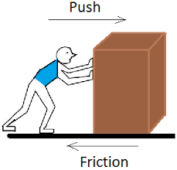
Factors affecting Friction
There two factors affecting friction that are : -
1. Nature of Surfaces
2. Pressure Applied to the two Surfaces

Slide 4
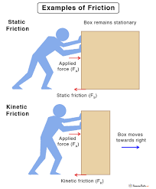
Types of Friction
There are two types of friction:-
1. Static Friction
2. Kinetic Friction

Slide 5
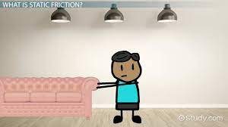
Static Friction
The Static Friction is a Friction that occur when two bodies are in rest.
Examples :-
1. A car moving from rest.
2. Moving a sofa from rest.

Slide 6
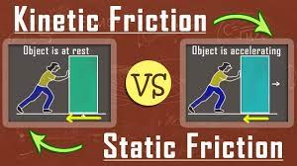
Kinetic Friction
Kinetic Friction Define as given as the resistance towards the motion caused by the contact between a surface and the moving object against it. The force of Kinetic Friction acts in the oppose of the moving object.
Example :- If two systems are in contact and moving relative to one another, then the friction between them is called kinetic friction.

Slide 7
!!!! THANK YOU!!!!

